Slide 1
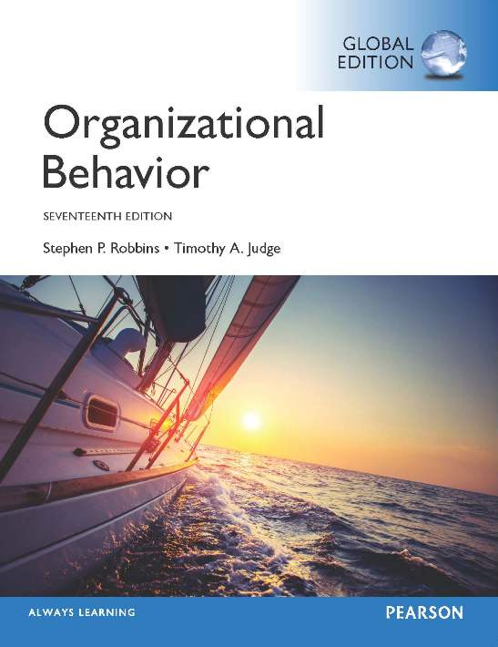
Notes:
Welcome to this Organizational Behavior course that uses the 17th edition of the textbook, Organizational Behavior by Robbins and Judge. This is considered among the most widely used OB textbooks in the world. Robbins and Judge are recognized as definitive aggregators of OB concepts, applications, and practices. The course and this book will provide you with a resource that will benefit you throughout your degree program and your professional life.

Slide 2
6
Perception and
Individual
Decision Making
Notes:
Chapter 6: Perception and Decision Making

Slide 3


Learning Objectives
Explain the factors that influence perception.
Describe attribution theory.
Explain the link between perception and decision making.
Contrast the rational model of decision making with bounded rationality and intuition.
Explain how individual differences and organizational constraints affect decision making.
Contrast the three ethical decision criteria.
Describe the three-stage model of creativity.
Notes:
After studying this chapter, you should be able to:
Explain the factors that influence perception.
Describe attribution theory.
Explain the link between perception and decision making.
Contrast the rational model of decision making with bounded rationality and intuition.
Explain how individual differences and organizational constraints affect decision making.
Contrast the three ethical decision criteria.
Describe the three-stage model of creativity.

Slide 4





Explain the Factors That Influence Perception
LO 1
Perception is a process by which individuals organize and interpret their sensory impressions in order to give meaning to their environment.
It is important to the study of OB because people’s behaviors are based on their perception of what reality is, not on reality itself.
Notes:
Perception is a process by which individuals organize and interpret their sensory impressions in order to give meaning to their environment. It is important to the study of OB because people’s behaviors are based on their perception of what reality is, not on reality itself.

Slide 5
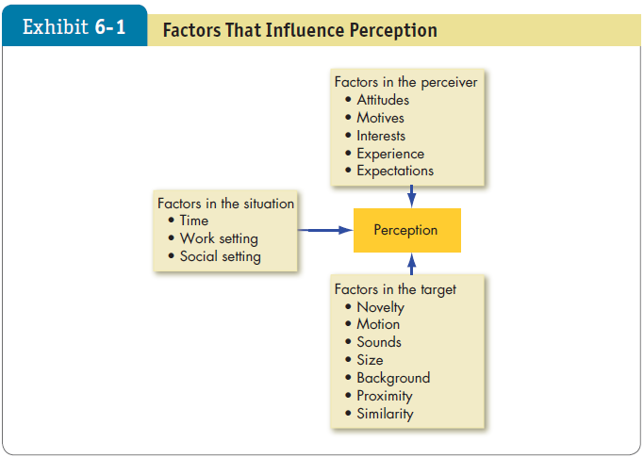

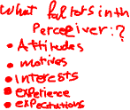
Explain the Factors That Influence Perception
LO 1
Notes:
Factors that shape and can distort perception include the perceiver, the target, or the situation, as shown here in Exhibit 6-1. When an individual looks at a target and attempts to interpret what he or she sees, that interpretation is heavily influenced by the personal characteristics of the individual perceiver. The more relevant personal characteristics affecting the perceptions of the perceiver are attitudes, motives, interests, past experiences, and expectations.

Slide 6
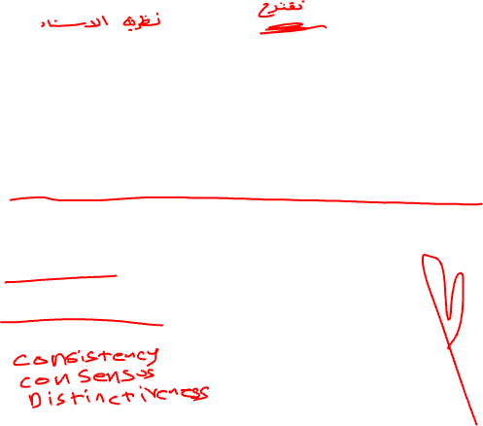

Explain Attribution Theory
LO 2
Attribution theory suggests that when we observe an individual’s behavior, we attempt to determine whether it was internally or externally caused.
Determination depends on three factors:
Distinctiveness
Consensus
Consistency
Notes:
Attribution theory suggests that when we observe an individual’s behavior, we attempt to determine whether it was internally or externally caused. That determination depends largely on three factors: distinctiveness, consensus, and consistency. We’ll talk more about each of these in a minute.

Slide 7


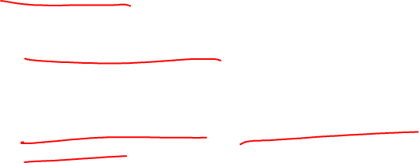
Explain Attribution Theory
LO 2
Clarification of the differences between internal and external causation
Internally caused – those that are believed to be under the personal control of the individual.
Externally caused – resulting from outside causes.
Notes:
First, let’s clarify the differences between internal and external causation. Internally caused behaviors are those that are believed to be under the personal control of the individual. Externally caused behavior is seen as resulting from outside causes; that is, the person is seen as having been forced into the behavior by the situation.

Slide 8
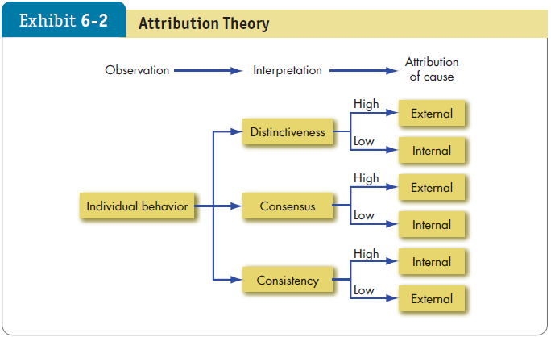
Explain Attribution Theory
LO 2
Notes:
Now, let’s look at each of the three determining factors shown here in Exhibit 6-2, more closely. Distinctiveness refers to whether an individual displays different behaviors in different situations. Consensus occurs if everyone who is faced with a similar situation responds in the same way. Finally, is there consistency in a person’s actions.

Slide 9



Explain Attribution Theory
LO 2
Fundamental attribution error
We have a tendency to underestimate the influence of external factors and overestimate the influence of internal or personal factors.
Self-serving bias
Individuals attribute their own successes to internal factors.
Notes:
Errors or biases can distort attributions. Fundamental attribution error occurs when we underestimate the influence of external factors and overestimate the influence of internal or personal factors. Self-serving bias occurs when individuals attribute their own successes to internal factors, such as ability or effort, while putting the blame for failure on external factors, such as luck.

Slide 10

Explain Attribution Theory
LO 2
Common Shortcuts in Judging Others
Selective perception
Any characteristic that makes a person, object, or event stand out will increase the probability that it will be perceived.
Since we can’t observe everything going on around us, we engage in selective perception.
Notes:
We use a number of shortcuts when we judge others, but it’s important to recognize that while these shortcuts can be helpful, they can also result in significant distortions.
Let’s begin with selective perception. Any characteristic that makes a person, object, or event stand out will increase the probability that it will be perceived. Since we can’t observe everything going on around us, we engage in selective perception.

Slide 11




Explain Attribution Theory
LO 2
Halo effect
The halo effect occurs when we draw a general impression on the basis of a single characteristic.
Contrast effects
We do not evaluate a person in isolation.
Our reaction to one person is influenced by other persons we have recently encountered.
يتأثر رد فعلنا تجاه شخص واحد بأشخاص آخرين قابلناهم مؤخرًا
Notes:
Another shortcut is the halo effect, which occurs when we draw a general impression on the basis of a single characteristic.
A third shortcut involves contrast effects. We do not evaluate a person in isolation. Our reaction to one person is influenced by other individuals we have recently encountered. For example, an interview situation in which one sees a pool of job applicants can distort perception. Distortions of any given candidate’s evaluation can occur as a result of his or her place in the interview schedule.

Slide 12


Explain Attribution Theory
LO 2
Stereotyping
Judging someone on the basis of our perception of the group to which he or she belongs.
We have to monitor ourselves to make sure we’re not unfairly applying a stereotype in our evaluations and decisions.
Notes:
A fourth shortcut is stereotyping, wherein we judge someone on the basis of our perception of the group to which he or she belongs. Generalization is not without advantages – it is a means of simplifying a complex world, and it permits us to maintain consistency. The problem, of course, is when we inaccurately stereotype. We have to monitor ourselves to make sure we’re not unfairly applying a stereotype in our evaluations and decisions.

Slide 13
Explain Attribution Theory
LO 2
Applications of Shortcuts in Organizations
Employment Interview
Evidence indicates that interviewers make perceptual judgments that are often inaccurate.
Interviewers generally draw early impressions that become very quickly entrenched.
Studies indicate that most interviewers’ decisions change very little after the first four or five minutes of the interview.
Notes:
Let’s look at some specific applications of shortcuts in organizations.
The first application is the employment interview. Evidence indicates that interviewers make perceptual judgments that are often inaccurate. Moreover, early impressions can become quickly entrenched. In fact, research shows that most interviewers’ decisions change very little after the first few minutes of an interview.

Slide 14


Explain Attribution Theory
LO 2
Performance Expectations
Evidence demonstrates that people will attempt to validate their perceptions of reality, even when those perceptions are faulty.
Self-fulfilling prophecy, or the Pygmalion effect, characterizes the fact that people’s expectations determine their behavior.
Expectations become reality.
Notes:
The second application of shortcuts involves performance expectations. Evidence demonstrates that people will attempt to validate their perceptions of reality, even when those perceptions are faulty. Self-fulfilling prophecy, or the Pygmalion effect, characterizes the fact that people’s expectations determine their behavior. Expectations become reality.

Slide 15



Explain Attribution Theory
LO 2
Performance Evaluation
An employee’s performance appraisal is very much dependent upon the perceptual process.
Many jobs are evaluated in subjective terms.
Subjective measures are problematic because of selective perception, contrast effects, halo effects, and so on.
Notes:
The third application of shortcuts involves performance evaluation. An employee’s performance appraisal is very much dependent upon the perceptual process. Although the appraisal can be objective, many jobs are evaluated in subjective terms. Subjective measures can be problematic because of selective perception, contrast effects, halo effects, and so on.

Slide 16



Explain the Link Between Perception and Decision Making
LO 3
Individuals make decisions – choosing from two or more alternatives.
Decision making occurs as a reaction to a problem.
There is a discrepancy between some current state of affairs and some desired state, requiring consideration of alternative courses of action.
One person’s problem is another’s satisfactory state of affairs.
Notes:
Individuals in organizations constantly make decisions. They make choices from among two or more options many times during the day, and at different levels of importance or intensity.
Usually, decision making occurs as a reaction to a problem: there is a discrepancy between some current state of affairs and some desired state, requiring consideration of alternative courses of action. One person’s problem is another’s satisfactory state of affairs.
Every decision requires interpretation and evaluation of information. Data are typically received from multiple sources. The perceptions of the decision maker will decide which data are relevant to the decision and which are not. Alternatives will be developed, and the strengths and weaknesses of each need to be evaluated.

Slide 17
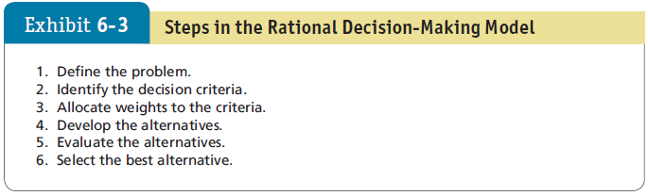

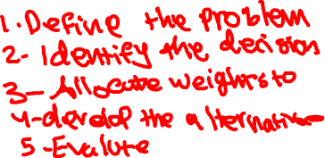
Rational Model of Decision Making vs. Bounded Rationality and Intuition
LO 4
Notes:
We often think the best decision maker is rational and makes consistent, value-maximizing choices within specified constraints. This Rational Decision Making process follows six steps, as shown here in Exhibit 6-3.
Step 1: Define the problem.
Step 2: Identify the decision criteria.
Step 3: Allocate weights to the criteria.
Step 4: Develop the alternatives.
Step 5: Evaluate the alternatives.
Step 6: Select the best alternative.

Slide 18



Rational Model of Decision Making vs. Bounded Rationality and Intuition
LO 4
Assumptions of the Rational Model
The decision maker…
Has complete information.
Is able to identify all the relevant options in an unbiased manner.
Chooses the option with the highest utility.
Most decisions in the real world don’t follow the rational model.
Notes:
The rational decision-making model assumes the decision maker has complete information, is able to identify all the relevant options in an unbiased manner, and chooses the option with the highest utility.
Most decisions in the real world don’t follow the rational model. People are usually content to find an acceptable or reasonable solution to a problem rather than an optimal one. Choices tend to be limited to the neighborhood of the problem symptom and the current alternative. As one expert in decision making put it, “Most significant decisions are made by judgment, rather than by a defined prescriptive model.” People are remarkably unaware of making suboptimal decisions.

Slide 19

Rational Model of Decision Making vs. Bounded Rationality and Intuition
LO 4
Bounded Rationality
Most people respond to a complex problem by reducing it to a level at which it can be readily understood.
People satisfice – they seek solutions that are satisfactory and sufficient.
Individuals operate within the confines of bounded rationality.
They construct simplified models that extract the essential features.
Notes:
When faced with a complex problem, most people respond by reducing the problem to a level at which it can be readily understood. This is because the limited information-processing capability of human beings makes it impossible to assimilate and understand all the information necessary to optimize. Instead, people satisfice; that is, they seek solutions that are satisfactory and sufficient. Individuals operate within the confines of bounded rationality and construct simplified models that extract the essential features.

Slide 20
Rational Model of Decision Making vs. Bounded Rationality and Intuition
LO 4
How does bounded rationality work?
Once a problem is identified, the search for criteria and options begins.
A limited list of the more conspicuous choices is identified.
The decision maker then reviews the list, looking for a solution that is “good enough.”
Notes:
How does bounded rationality work? Once a problem is identified, the search for criteria and options begins. The decision maker will identify a limited list made up of the more conspicuous choices, which are easy to find, tend to be highly visible, and represent familiar criteria and previously tried-and-true solutions. Once this limited set of options is identified, the decision maker will begin reviewing it.
The decision maker will begin with options that differ only in a relatively small degree from the choice currently in effect. The first option that meets the “good enough” criterion ends the search. (Satisficing is not always a bad idea. It is a simple process that may frequently be more sensible than the traditional rational decision-making model.)
To use the rational model in the real world, you need to gather a great deal of information about all the options, compute applicable weights, and then calculate values across a huge number of criteria. All these processes can cost time, energy, and money. If there are many unknown weights and preferences, the fully rational model may not be any more accurate than a best guess. Sometimes a fast-and-frugal process of solving problems is the best option.

Slide 21



Rational Model of Decision Making vs. Bounded Rationality and Intuition
LO 4
Intuition
Intuitive decision making occurs outside conscious thought; it relies on holistic associations, or links between disparate pieces of information, is fast, and is affectively charged, meaning it usually engages the emotions.
The key is neither to abandon nor rely solely on intuition, but to supplement it with evidence and good judgment.
Notes:
Another important decision-making technique is intuition. Perhaps the least rational way of making decisions, intuitive decision making is an unconscious process created from distilled experience. It occurs outside conscious thought, relies on holistic associations, or links between disparate pieces of information, is fast, and is affectively charged, meaning it usually engages the emotions. While intuition isn’t rational, it isn’t necessarily wrong. Nor does it always contradict rational analysis; rather, the two can complement each other. The key is neither to abandon nor rely solely on intuition, but to supplement it with evidence and good judgment.

Slide 22
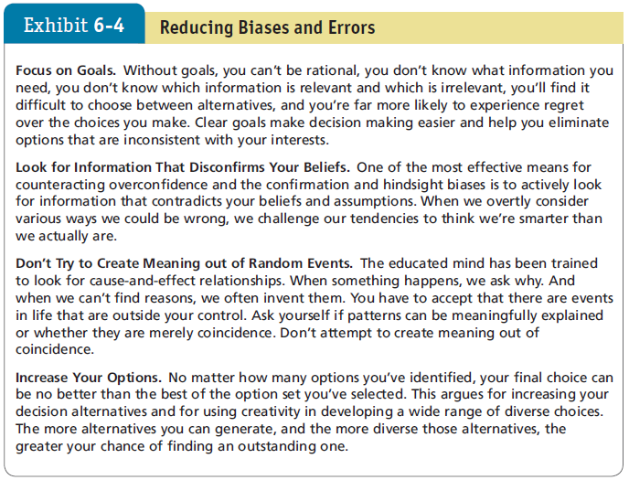
Rational Model of Decision Making vs. Bounded Rationality and Intuition
LO 4
Notes:
Decision makers allow systematic biases and errors to creep into their judgments. People tend to rely on experience, impulses, gut feelings, and rules of thumb, which can all lead to distortions. Exhibit 6-4 suggests some techniques to avoid decision biases or errors.
Let’s now take a look at the specific types of biases and errors that can occur in the decision-making process.

Slide 23



Rational Model of Decision Making vs. Bounded Rationality and Intuition
LO 4
Common Biases and Errors in Decision Making
Overconfidence Bias: individuals whose intellectual and interpersonal abilities are weakest are most likely to overestimate their performance and ability.
Anchoring Bias: fixating on initial information as a starting point and failing to adequately adjust for subsequent information.
Notes:
The first is overconfidence bias. Individuals whose intellectual and interpersonal abilities are weakest are most likely to overestimate their performance and ability. The tendency to be too confident about their ideas might keep some from planning how to avoid problems that arise. Investor overconfidence operates in a variety of ways. People think they know more than they do, and it costs them. Investors, especially novices, overestimate not just their own skill in processing information, but also the quality of the information with which they’re working.
A second bias is anchoring bias. This involves fixating on initial information as a starting point and failing to adequately adjust for subsequent information. Anchors are widely used by people in advertising, management, politics, real estate, and law, where persuasion skills are important. Any time a negotiation takes place, so does anchoring.

Slide 24



Rational Model of Decision Making vs. Bounded Rationality and Intuition
LO 4
Confirmation Bias: type of selective perception.
Seek out information that reaffirms past choices, and discount information that contradicts past judgments.
Availability Bias: tendency for people to base judgments on information that is readily available.
Notes:
A third bias is confirmation bias. It is a type of selective perception. Here we seek out information that reaffirms past choices, and discount information that contradicts past judgments.
Fourth is availability bias, or the tendency for people to base judgments on information that is readily available.

Slide 25



Rational Model of Decision Making vs. Bounded Rationality and Intuition
LO 4
Escalation of Commitment: staying with a decision even when there is clear evidence that it’s wrong.
Likely to occur when individuals view themselves as responsible for the outcome.
Randomness Error: our tendency to believe we can predict the outcome of random events.
Decision making becomes impaired when we try to create meaning out of random events.
Notes:
Escalation of commitment is a bias that occurs when we stay with a decision even when there is clear evidence that it’s wrong. This type of bias is most likely to occur when individuals view themselves as responsible for the outcome.
Another bias is randomness error, which is rooted in our tendency to believe we can predict the outcome of random events. Decision making becomes impaired when we try to create meaning out of random events.

Slide 26
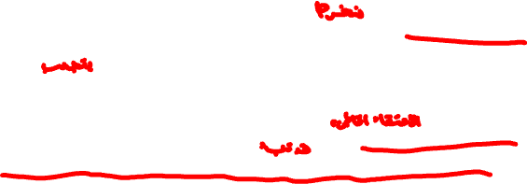
Rational Model of Decision Making vs. Bounded Rationality and Intuition
LO 4
Risk Aversion: the tendency to prefer a sure thing instead of a risky outcome.
Ambitious people with power that can be taken away appear to be especially risk averse.
People will more likely engage in risk-seeking behavior for negative outcomes, and risk-averse behavior for positive outcomes, when under stress.
Hindsight Bias: the tendency to believe falsely that one has accurately predicted the outcome of an event, after that outcome is actually known.
Notes:
Another bias, risk aversion, is the tendency to prefer a sure thing instead of a risky outcome. Risk aversion has important implications. Risk-averse employees will stick with the established way of doing their jobs, rather than taking a chance on innovative or creative methods. Ambitious people with power that can be taken away (i.e., most managers) appear to be especially risk averse, perhaps because they don’t want to lose everything they’ve worked so hard to achieve. Generally speaking, people will more likely engage in risk-seeking behavior for negative outcomes, and risk-averse behavior for positive outcomes, when under stress.
Finally, hindsight bias is the tendency to believe falsely that one has accurately predicted the outcome of an event, after that outcome is actually known. Hindsight bias reduces our ability to learn from the past.

Slide 27




Individual Differences, Organizational Constraints, and Decision Making
LO 5
Individual Differences
Personality
Conscientiousness
High self-esteem
Gender
Rumination
Mental Ability
Cultural Differences
Nudging
Notes:
Individual differences and organizational constraints also affect decision making.
/
Personality influences our decisions. Specific facets of conscientiousness—rather than the broad trait itself—may affect escalation of commitment.
Achievement-striving people are more likely to escalate their commitment, whereas dutiful people are less likely to do so. Achievement-oriented people hate to fail, so they escalate their commitment, hoping to forestall failure. Dutiful people, by contrast, are more inclined to do what they see as best for the organization. People with high self-esteem are strongly motivated to maintain it, so they use the self-serving bias to preserve it.
Additional individual characteristics include gender. For example, women, in general, are more likely than men to engage in rumination. Rumination refers to reflecting at length; in decision making, it translates to over-thinking problems. Evidence indicates that women analyze decisions more than men. The rumination tendency appears to be moderated by age. Differences are largest during young adulthood and smallest after age 65.
Next is mental ability. We know people with higher levels of mental ability are able to process information more quickly, solve problems more accurately, and learn faster, so you might expect them also to be less susceptible to common decision errors.
Cultural differences also come into play. The rational model makes no acknowledgment of cultural differences, nor does the bulk of OB research literature on decision making. However, it is important to recognize that the cultural background of a decision maker can significantly influence the selection of problems, the depth of analysis, the importance placed on logic and rationality, and whether organizational decisions should be made autocratically by an individual manager or collectively in groups. Cultures differ in their time orientation, the importance of rationality, their belief in the ability of people to solve problems, and their preference for collective decision making. While rationality is valued in North America, that’s not true elsewhere in the world.
Some cultures emphasize solving problems, while others focus on accepting situations as they are. The United States falls in the first category, while Thailand and Indonesia are examples of the second. Because problem-solving managers believe they can and should change situations to their benefit, U.S. managers might identify a problem long before their Thai or Indonesian counterparts would choose to recognize it. Decision making by Japanese managers is much more group-oriented than in the United States. The Japanese value conformity and cooperation. Before Japanese CEOs make an important decision, they collect a large amount of information, which they use in consensus-forming group decisions. In short, there are probably important cultural differences in decision making, but unfortunately there is not yet much research to identify them.
Finally, commercials are one of the most outright forms of an organization’s attempt to influence our perceptions of a product and our decision to acquire that product. Nudging has also been used positively in the development of corporate social responsibility (CSR) initiatives to change people’s expectations for organizations. People differ in their susceptibility to suggestion, but it is probably fair to say we are all receptive to nudging to some degree.

Slide 28





Individual Differences, Organizational Constraints, and Decision Making
LO 5
Organizational Constraints
Performance Evaluation Systems
Reward Systems
Formal Regulations
System-Imposed Time Constraints
Historical Precedents
Notes:
Organizational constraints that impinge on decision making begin with performance evaluation. Managers are strongly influenced in their decision making by the criteria by which they are evaluated. The organization’s reward system influences decision makers by suggesting to them what choices are preferable in terms of personal payoff.
Other constraints are the formal rules, policies, procedures, and other formalized regulations created by organizations to standardize the behavior of their members. System-imposed time constraints are another influence wherein organizations impose deadlines on decisions.
Finally, historical precedents can serve to impede decision making. Decisions have a context. Individual decisions are more accurately characterized as points in a stream of decisions. Decisions made in the past are ghosts, which continually haunt current choices. For example, it is common knowledge that the largest determining factor of the size of any given year’s budget is last year’s budget.

Slide 29


Contrast the Three Ethical Decision Criteria
LO 6
Utilitarianism: decisions are made solely on the basis of their outcomes or consequences.
Focus on rights: calls on individuals to make decisions consistent with fundamental liberties and privileges as set forth in documents such as the Bill of Rights.
Protects whistle-blowers.
Impose and enforce rules fairly and impartially to ensure justice or an equitable distribution of benefits and costs.
Notes:
Ethical considerations should be an important criterion in organizational decision making. The first is utilitarianism, which occurs when decisions are made solely on the basis of their outcomes or consequences. The focus on rights calls on individuals to make decisions consistent with fundamental liberties and privileges as set forth in documents such as the Bill of Rights; this particular criterion protects whistle-blowers in organizations. The third criterion involves imposing and enforcing rules fairly and impartially to ensure justice or an equitable distribution of benefits and costs. Union members typically favor this view.
Each criterion has advantages and liabilities. A focus on utilitarianism promotes efficiency and productivity, but it can sideline the rights of some individuals, particularly those with minority representation. The focus on rights protects individuals from injury and is consistent with freedom and privacy, but it can create a legalistic environment that hinders productivity and efficiency. A focus on justice protects the interests of the underrepresented and less powerful, but it can encourage a sense of entitlement that reduces risk taking, innovation, and productivity.

Slide 30
Contrast the Three Ethical Decision Criteria
LO 6
Behavioral ethics: an area of study that analyzes how people actually behave when confronted with ethical dilemmas.
Individuals do not always follow ethical standards promulgated by their organizations, and we sometimes violate our own standards.
There are ways to increase ethical decision making in organizations.
Consider cultural differences.
Notes:
Increasingly, researchers are turning to behavioral ethics – an area of study that analyzes how people actually behave when confronted with ethical dilemmas. Their research tells us that while ethical standards exist collectively (e.g., in society and organizations) and individually (e.g., personal ethics), individuals do not always follow ethical standards promulgated by their organizations and we sometimes violate our own standards.
How might we increase ethical decision making in organizations? First, sociologist James Q. Wilson promulgated the broken windows theory – the idea that decayed and disorderly urban environments may facilitate criminal behavior because they signal antisocial norms. Second, managers should encourage conversations about moral issues; they may serve as a reminder and increase ethical decision making. Finally, we should be aware of our own moral “blind spots” – the tendency to see ourselves as more moral than we are, and others as less moral than they are.
Behavioral ethics research stresses the importance of culture in ethical decision making. What is ethical in one culture may be unethical in another.
Without sensitivity to cultural differences in defining ethical conduct, organizations may encourage unethical conduct without even knowing it.

Slide 31

Contrast the Three Ethical Decision Criteria
LO 6
Lying
One of the top unethical activities we may indulge in daily.
It undermines all efforts toward sound decision making.
Managers—and organizations—simply cannot make good decisions when facts are misrepresented and people give false motives for their behaviors.
Lying is a big ethical problem as well.
Notes:
Lying is one of the top unethical activities we may indulge in daily, and it undermines all efforts toward sound decision making. Lying is deadly to decision making, whether we sense the lies or not. Managers—and organizations—simply cannot make good decisions when facts are misrepresented and people give false motives for their behaviors.
Lying is a big ethical problem as well.

Slide 32


Describe the Three-Stage Model of Creativity
LO 7
Creativity is the ability to produce novel and useful ideas.
These are ideas that are different from what has been done before, but that are also appropriate to the problem.
Notes:
Creativity is the ability to produce novel and useful ideas.

Slide 33
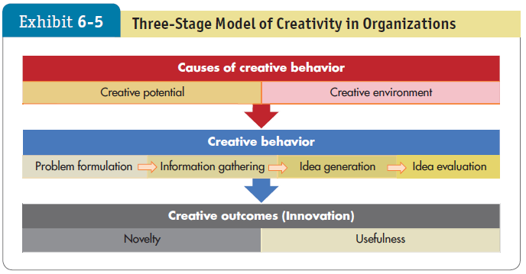

Describe the Three-Stage Model of Creativity
LO 7
Notes:
The three-stage model of creativity shown in Exhibit 6-5 suggests that creativity involves causes (creative potential and creative environment), creative behavior, and creative outcomes (innovation).
The first stage, causes of creative behavior, is comprised of creative potential and creative environment. Most people have some of the characteristics shared by exceptionally creative people, but the more of these characteristics we have, the higher our creative potential. The potential for creativity is enhanced when individuals have abilities, knowledge, proficiencies, and similar expertise to their field of endeavor.
What environmental factors affect whether creative potential translates into creative behaviors? First and perhaps most important is motivation. If you aren’t motivated to be creative, it is unlikely you will be. It is also valuable to work in an environment that rewards and recognizes creative work. A recent nation-level study suggests that countries scoring high on Hofstede’s culture dimension of individuality are more creative. Good leadership matters to creativity, too. Studies show that diverse teams can be more creative, but only under certain conditions.
Creative behavior occurs in four steps, each of which leads to the next:
Problem formulation: any act of creativity begins with a problem that the behavior is designed to solve.
Problem formulation: the stage of creative behavior in which we identify a problem or opportunity that requires a solution as yet unknown.
Information gathering: the stage of creative behavior when possible solutions to a problem incubate in an individual’s mind.
Idea generation: the process of creative behavior in which we develop possible solutions to a problem from relevant information and knowledge.
Idea evaluation: the process of creative behavior in which we evaluate potential solutions to identify the best one.
Lastly, we can define creative outcomes as ideas or solutions judged to be novel and useful by relevant stakeholders. Novelty itself does not generate a creative outcome if it isn’t useful; thus, “off-the-wall” solutions are creative only if they help solve the problem. Softs skills help translate ideas into results. Another important factor is organizational climate. A study of health care teams found that team creativity translated into innovation only when the climate actively supported innovation.

Slide 34
Implications for Managers
Behavior follows perception, so to influence behavior at work, assess how people perceive their work. Often behaviors we find puzzling can be explained by understanding the initiating perceptions.
Make better decisions by recognizing perceptual biases and decision-making errors we tend to commit. Learning about these problems doesn’t always prevent us from making mistakes, but it does help.
Notes:
Individuals base their behavior not on the way their external environment actually is, but rather on the way they see it or believe it to be. An understanding of the way people make decisions can help us explain and predict behavior, but few important decisions are simple or unambiguous enough for the rational model’s assumptions to apply. We find individuals looking for solutions that satisfice rather than optimize, injecting biases and prejudices into the decision process, and relying on intuition.
Managers should encourage creativity in employees and teams to create a route to innovative decision making. Specific implications for managers are:
Behavior follows perception, so to influence behavior at work, assess how people perceive their work. Often behaviors we find puzzling can be explained by understanding the initiating perceptions.
Make better decisions by recognizing perceptual biases and decision-making errors we tend to commit. Learning about these problems doesn’t always prevent us from making mistakes, but it does help.

Slide 35
Implications for Managers
Adjust your decision-making approach to the national culture you’re operating in and to the criteria your organization values. If you’re in a country that doesn’t value rationality, don’t feel compelled to follow the rational decision- making model or to try to make your decisions appear rational. Adjust your decision approach to ensure compatibility with the organizational culture.
Notes:
Adjust your decision-making approach to the national culture you’re operating in and to the criteria your organization values. If you’re in a country that doesn’t value rationality, don’t feel compelled to follow the rational decision-making model or to try to make your decisions appear rational. Adjust your decision approach to ensure compatibility with the organizational culture.

Slide 36
Implications for Managers
Combine rational analysis with intuition. These are not conflicting approaches to decision making. By using both, you can actually improve your decision making effectiveness.
Try to enhance your creativity. Actively look for novel solutions to problems, attempt to see problems in new ways, use analogies, and hire creative talent. Try to remove work and organizational barriers that might impede your creativity.
Notes:
Combine rational analysis with intuition. These are not conflicting approaches to decision making. By using both, you can actually improve your decision making effectiveness.
Try to enhance your creativity. Actively look for novel solutions to problems, attempt to see problems in new ways, use analogies, and hire creative talent. Try to remove work and organizational barriers that might impede your creativity.

